Slide 1



Solution for McDonald's
Supply Shortage Problem
Focusing on the Hub-and-Spoke Supply Chain Model
Hyun Jin (Hena) Ahn
2024.05.03

Slide 2





Agenda
01
Introduction
Solution for McDonald's
04
Suggestion
02
Problem Statement
05
Conclusion
03
Data Analysis
1

Slide 3

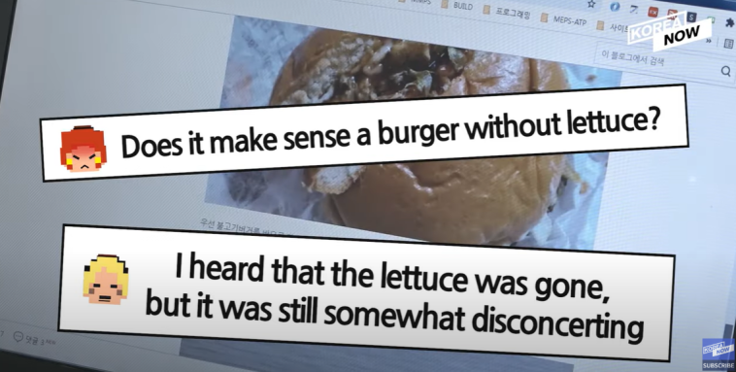
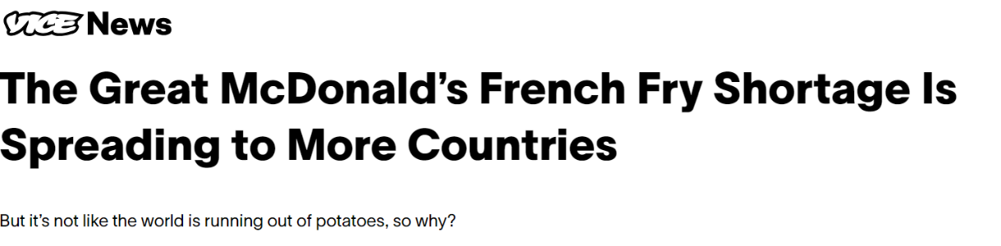
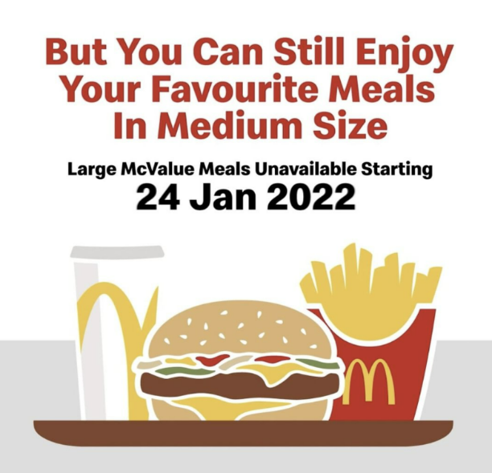
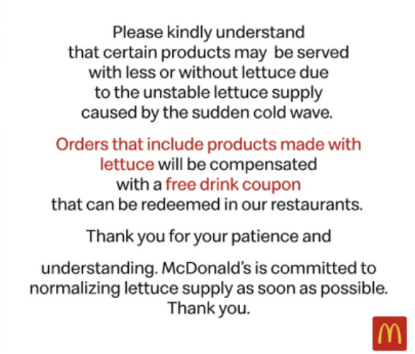
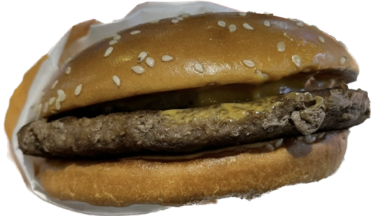
01
Introduction
2
Notes:
Recently in 2022, a lot of countries worldwide have faced the french fry shortage issue. Some countries were facing this issue for more than a month, and some McDonald’s in some countries tried to mitigate this issue by making these kinds of announcements. ‘ But you can still enjoy your favorite meals in medium size’, since customers weren't allowed to buy french fries in large size. Not only the french fries, but also other ingredients such as lettuce or tomatoes faced the same issue. Especially in Korea, due to the extreme weather conditions such as heatwaves and heavy rainfall, it impacted the local farms which are the McDonald’s key suppliers, leading to insufficient lettuce production and subsequent price hikes. At that time ,customers were served hamburgers without lettuce as you can see in this picture with a free drink coupon. However, is limiting the size of the french fries that customers can buy, and serving hamburgers without lettuce with a free drink coupon is the ultimate solution?

Slide 4


02
Problem Statement
McDonald's faces supply chain issues due to heavy reliance on local suppliers, causing disruptions during environmental stress and market fluctuations.
United Kingdom
South Korea
Japan
Taiwan
Malaysia
Phillippine
Singapore
3
Notes:
McDonald’s is facing supply chain issues due to heavy reliance on local suppliers which causes disruptions during the environmental stress and market fluctuations. In this map, it is showing the countries that faced supply shortages only in 2022 which was the peak of the year that numerous countries faced the problem.

Slide 5
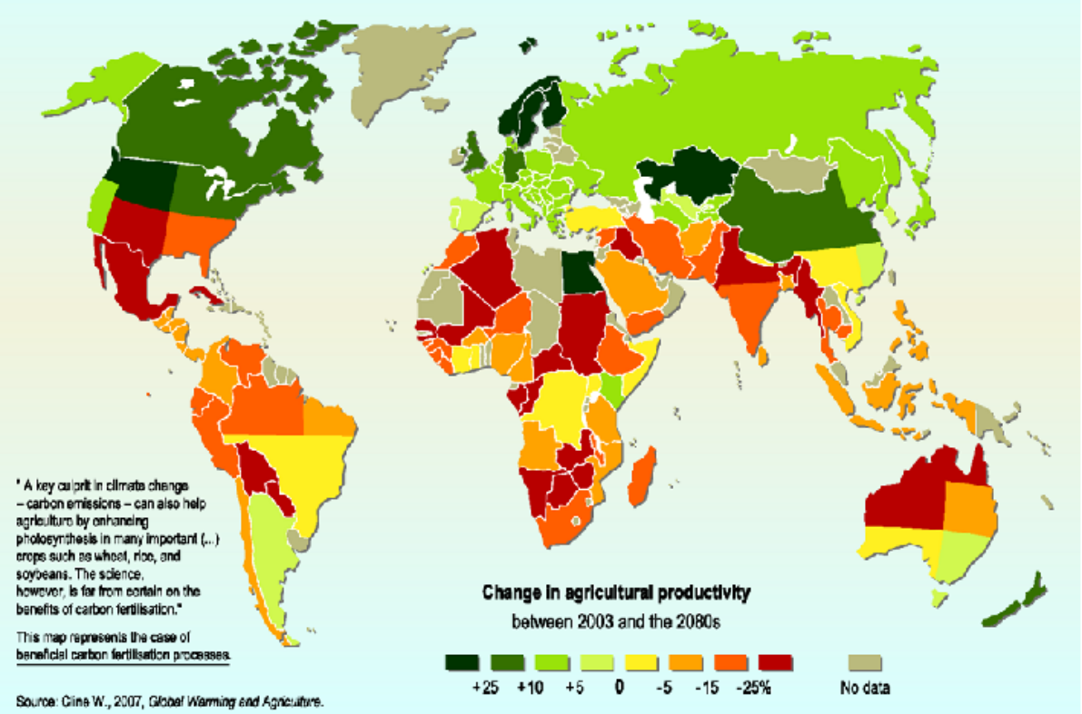
Agriculture is the most vulnerable sector to climate change causing huge economic impacts.The changes in climatic events such as temperature and rainfall significantly affect the yield of crops.(Gurdeep et al., 2021)
4
Notes:
Agriculture is the most vulnerable sector to climate change. Think about the ingredients of McDonald’s food. Fresh vegetables and crops are the key. However, the changes in climatic events are affecting the yield of crops, which means that when some countries experience poor harvests while others have bountiful harvests, it intensifies the imbalance in not only the agricultural production but also the prices among countries. In industries with intense price competition like fast food, these can be critical issues. Therefore, addressing the imbalance in agricultural product distribution and prices is crucial for stability and fairness.

Slide 6













Areas that faced Supply Shortage in 2022
Supply Category that faced Shortage in 2022
Japan
Malaysia
Indonesia
Singapore
Phillippine
South Korea
United Kingdom
South Korea
Taiwan
Japan
Malaysia
Phillippine
Singapore
United Kingdom
Key Facts of McDonald's Supply Chain
100% Outsourcing of Supplies
South Korea
Use Local Suppliers
5
Notes:
The key facts of McDonald’s supply chain is that 100% of the supplies are outsourced, and McDonald’s focuses on local suppliers. Before conducting the data analysis, I grouped the countries within the supply category that faced shortage in 2022. The key ingredients that faced supply shortage were potato, tomato, and lettuce.

Slide 7

Areas that faced Supply Shortage in 2022
Supply Category that faced Shortage in 2022
Japan
Malaysia
Indonesia
Singapore
Phillippine
South Korea
United Kingdom
South Korea
Taiwan
Japan
Malaysia
Phillippine
Singapore
United Kingdom
Key Facts of McDonald's Supply Chain
100% Outsourcing of Supplies
South Korea
Use Local Suppliers
6
Notes:
By the research, potato shortage was the most common supply that faced shortage in various countries.

Slide 8
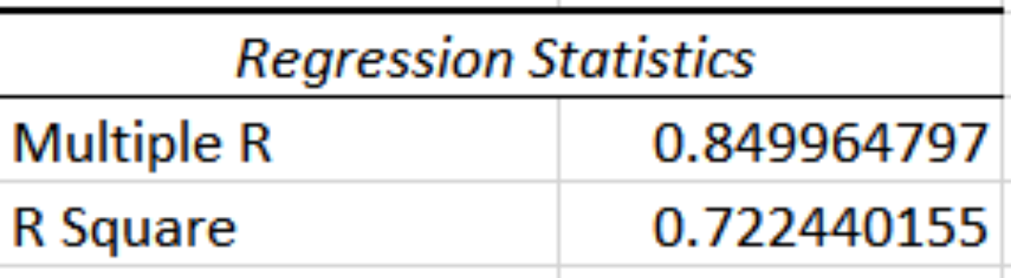
03
타임라인 페이지
Data Analysis Linear Regression
Objective
To understand the impact of supply shortages on revenue due to bad harvest years
Columns
Country, Revenue 2021, Revenue 2022, Potato Production 2021, Potato Production 2022,
Revenue Difference, Potato Production Difference
Sources
Food and Agriculture Organization of United Nations, McDonald's revenue data of selected countries
Result
Changes in potato production from 2021 to 2022 have a considerable impact on revenue changes in countries facing French Fries shortages
7

Slide 9
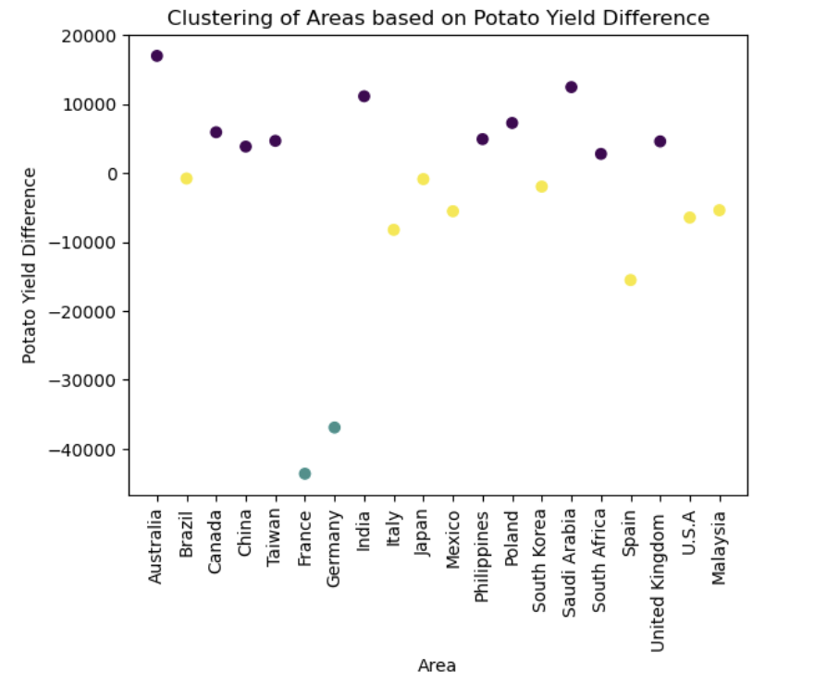
03
타임라인 페이지
Data Analysis Clustering
Objective
To identify clusters representing countries with certain yield differences, that indicate potential potato supply shortages
Columns
Country, Potato Yield Difference between 2021 and 2022
Sources
Food and Agriculture Organization of United Nations, McDonald's top 20 countries by number of restaurants
Result
60% accuracy rate in matching observed events of French Fries shortage issue
8

Slide 10



04
타임라인 페이지
Suggestion
Implement a Hub-and-Spoke Supply Chain Model Globally
Hub
Spoke
9

Slide 11






Hub-and-Spoke Global Supply Chain Model
Benefits
Product Availability
Quality and Freshness
Price Stability
Customers
Hub
Spoke
Stable Market and Price Economic Opportunities
Risk Mitigation
Overview
Farmers
Create a Subsidiary
Group Countries into Sectors or Regions
Connect the Hubs
Supply Chain Resilience Quality Assurance
Strategic Flexibility
McDonald's
10
Notes:
This suggestion follows the step of creating a subsidiary and placing it as the hub that manages the crop supplies. And then group the countries by considering regions and logistical routes and modes. And by connecting the hubs, even if a certain country faces a bad harvest or extreme weather conditions that disrupt the production of crops, the new supply chain model will help distribute the supplies timely.
From the customer's point of view, this improves menu item availability and consistency and also the stable price across McDonald's restaurants.
From the farmers and the local community’s view, this provides them with a stable and consistent market for their produce. By partnering with McDonald's through a subsidiary, farmers gain a reliable buyer for their crops, reducing the uncertainty of sales and ensuring a steady income stream. Also,it promotes sustainable farming practices and encourages farmers to adopt environmentally friendly methods, contributing to long-term economic growth and stability. By diversifying sales channels through the hub-and-spoke model, it reduces risks for farmers during challenging periods which enhances their resilience and sustainability.
From the McDonald’s point of view, it enhances McDonald's supply chain resilience by reducing dependencies on specific suppliers or regions. It ensures continuous ingredient supply, even during unforeseen disruptions or market fluctuations. They can ensure that customers receive high-quality, fresh ingredients in their meals, which can also enhance the brand trust and loyalty. Lastly, the model provides McDonald's with strategic flexibility to adapt to changing market conditions and supply chain challenges. It enables sourcing from alternative regions or suppliers, to maintain operational continuity and meet customer demands effectively.

Slide 12



05
타임라인 페이지
Conclusion
Key Impacts
Economic opportunities for farmers and local communities
Risk mitigation through diversified sourcing and supply chain resilience
Enhanced brand reputation and customer loyalty
Reduced environmental footprint and food waste
Contribution to long-term sustainability and corporate social responsibility
Key Considerations
Logistical
Complexity
Regulatory
Compliance
Supplier
Relationships
11

Slide 13

Thank You

